Slide 1



TempMate
Group 24
Perera W.S.M. EG/2021/4716
Weerasooriya W.M.I EG/2021/4859
Wickramasinghe B.G.D.D.A EG/2021/4861

Slide 2

Intro
TempMate is a smart mug that keeps your drink at the perfect sipping temperature.
Uses smart temperature sensing and PWM to control the heating intelligently.
Applies just the right amount of energy, saving battery and maintaining drink quality
Compact and portable – great for enjoying warm drinks anywhere, anytime.

Slide 3

What we have done so far,
Proteus simulation of the circuit
Algorithm of the Firmware
CAD Design for the mug
Peltier module testing
Temperature sensor testing

Slide 4
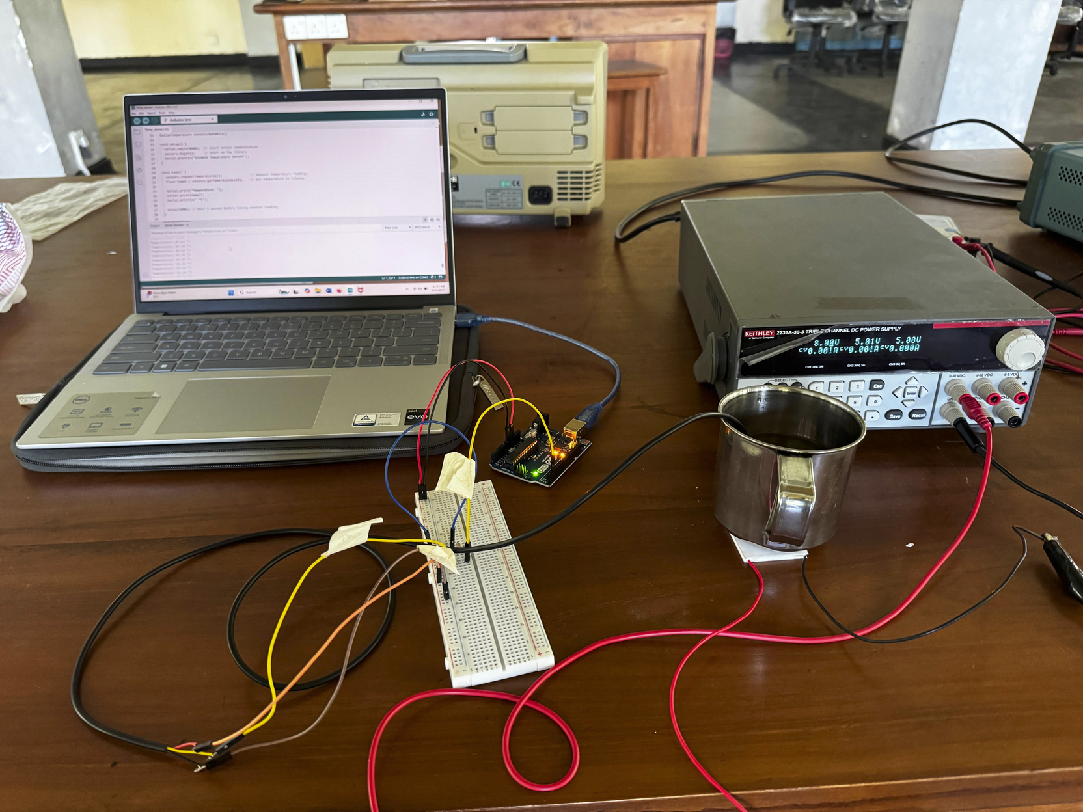
Problems Encountered
Peltier module was not enough to heat the water upto required temperature.

Slide 5

In progress
Testing the other two heating elements
PTC module
Coil
Programming the algorithm in Atmel studio

Slide 6
To Do,
Manually tuning the PID control loop.
Choosing the batteries according to current and voltage requirements.
Doing necessary changes to CAD design of the final product according to the hardware components

Slide 7
THANK YOU!

